Slide 1



T-20 World Cup 2022 Data Analysis

Slide 2


01
Welcome to the T-20 World Cup 2022 Data Science project.
Comprehensive data analysis, drawing meaningful insights from T-20 cricket.

Slide 3
02
The T-20 World Cup 2022 dataset provides a goldmine of cricket data.
Mission:
Data Exploration
In-Depth Analysis
Event Inference
Performance Evaluation
Statistical Insights

Slide 4
Data Exploration
03
Delve into the dataset to uncover trends, patterns, and insights.
Analyze the performance of teams, players, and key events within the matches.

Slide 5
In-Depth Analysis
Examine player statistics: runs, wickets, over-by-over progress.
Understand the dynamics of the game.
Gain insights into the performance of individual players and teams, and explore how their performances evolve throughout the matches.
Dive into the detailed player statistics including runs, wickets, and over-by-over progress.

Slide 6
Identify and analyze critical match events: boundaries, wickets, strategic moments.
Uncover factors contributing to team success or downfall.
Event Inference

Slide 7
Performance Evaluation
Evaluate individual and team performances
Identify standout players
Understand what sets them apart
Analyze the performance of players and teams throughout the T-20 World Cup 2022 matches.
Discover the top performers, consistent run-scorers, and top wicket-takers.
Uncover the factors that distinguish standout players and teams from the rest.

Slide 8
Statistical Insights
Utilize statistical techniques to gain insights into:
Team strategies
Batting and bowling performances
Match outcomes
Create visualizations that convey the story of the tournament.

Slide 9
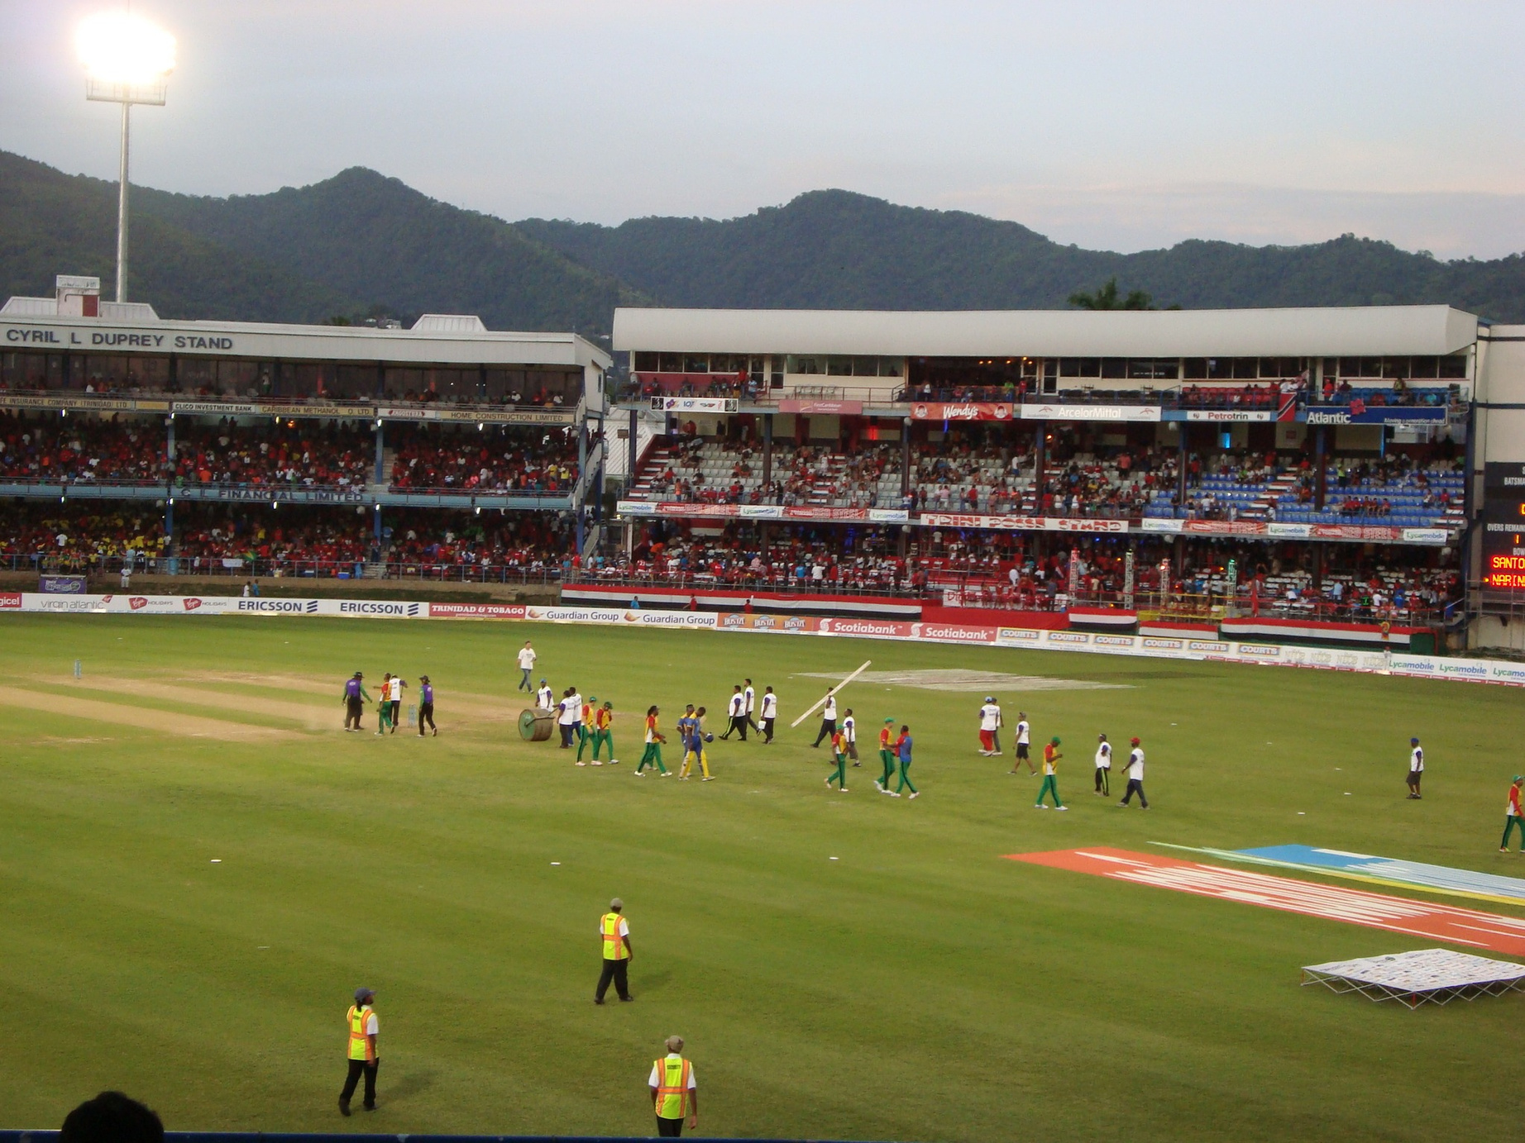
Dataset Overview
Detailed information on T-20 World Cup 2022 matches:
Match details
Player statistics
Match events
Commentary text

Slide 10
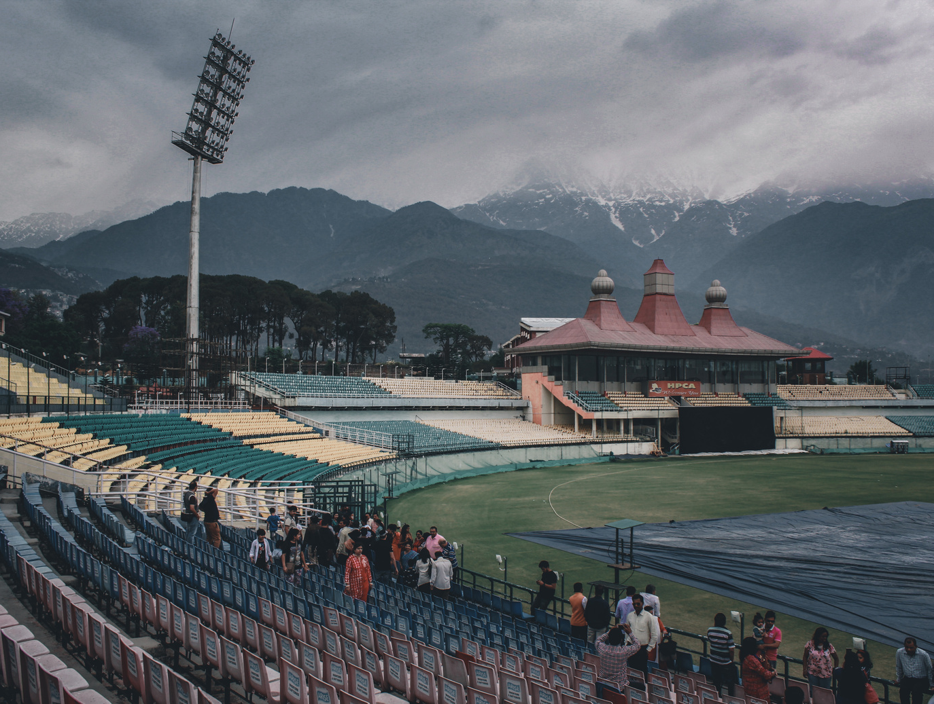
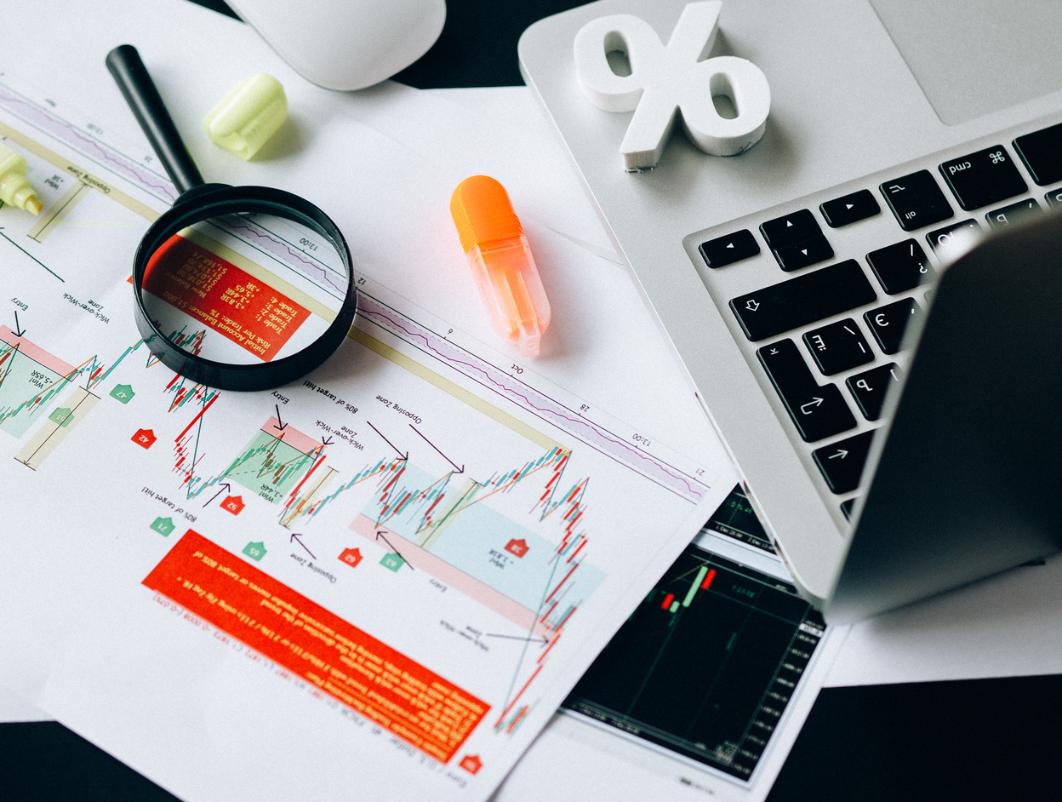
Conclusion
01
This project presents a thrilling opportunity to analyze real-world T-20 cricket data.
02
03
Develop strong analytical skills, hone data analysis techniques.
Provide a comprehensive understanding of the T-20 World Cup 2022.

